Slide 1
Supporting Internet Development
Philip Smith, Learning and Development Director

Slide 2
Overview
Training
APNIC Conferences
Policy
APNIC Labs
Root Servers
Information Society Innovation Fund

Slide 3
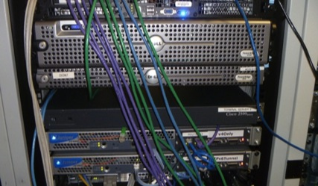
Training in 2011
Became part of Learning and Development Area
Increased focus on IPv6 Deployment
Introduced eLearning sessions (using WebEx)
  One-hour modules
  Delivered fortnightly to three time zones
  Schedule changing in 2012
Training Lab infrastructure upgraded
  Now supports 4-byte AS Numbers
  Topology resembles ISP with multiple operating regions
  Hands on environment with core, edge, and access networks

Slide 4
Courses Offered
Internet Resource Management
Internet Routing Registry
Internet Technologies
Routing
  OSPF and BGP
  IPv4 and IPv6
DNS and DNSSEC
Network Security
IPv6
  eLearning (1-hour modules)
    IPv6 Overview
    Addressing and Subnetting
    IPv4 – IPv6 Transition
  Workshop
    Two days, hands-on
  Tutorial
    Full day at APNIC 32

Slide 5
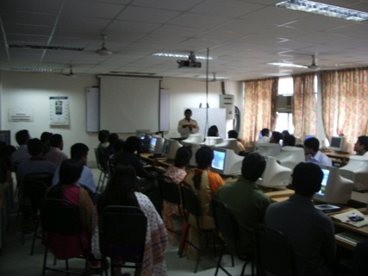
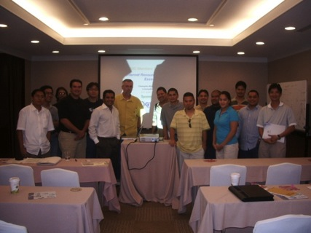
Training Delivered in 2011
Face-to-Face
  67 courses in 36 locations
  1,813 total participants
eLearning
  76 courses
  786 total participants
IPv6 courses
  27 locations in 20 economies
  1,147 total participants

Slide 6
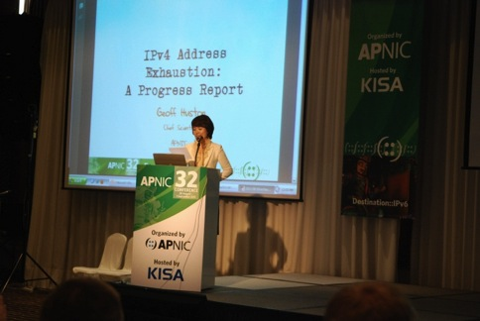
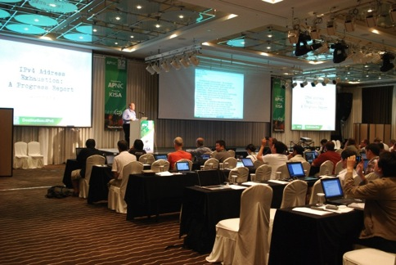
APNIC Conferences
APNIC 32
  Total delegates: 244
  Economies represented: 35
  APNIC Member organizations represented: 62
  Participants at APNIC Remote Hub in Phnom Penh: 25
  Total remote participants: 506

Slide 7
2011 Policy Outcomes
APNIC implemented the following policy proposals:
  May
    prop-088: Distribution of IPv4 addresses once the Final /8 period starts
    prop-093: Reducing the minimum delegation size for the Final /8 policy
    prop-094: Removing renumbering requirement from Final /8 policy
  August
    prop-083: Alternative criteria for subsequent IPv6 allocations
    prop-095: Inter-RIR address transfer proposal
  November
    prop-096: Maintaining demonstrated needs requirement in transfer policy after the Final /8 phase

Slide 8
Policies at APNIC 32
Did not reach consensus:
  prop-100: National IP address plan – Allocation of country-wide IP address blocks
  prop-099: IPv6 reservation for large networks
  prop-098: Optimizing IPv6 allocation strategies (simplified)
These proposals were returned to the mailing list for further discussion

Slide 9
APNIC Labs
Launched in 2011, focusing on several activities
IPv6 Capability Tracker
  Google Analytics Tracking Tool to allow website operators to measure client IPv6 capabilities
Measuring IPv6
  Measuring the end-to-end capability of IPv6 clients per economy
IPv6 preference by ASN
  Measures IPv6 client capability per autonomous system
IPv4 address report
  Measuring IPv4 free pool address exhaustion
Website: labs.apnic.net
Blog: blabs.apnic.net

Slide 10
Root Server Deployment
APNIC helped launch two additional root server instances in 2011:
Bhutan
  Operator: I-root
  Local host: Bhutan Telecom
  Location: Thimphu
  Status: Operational from April 2011
Mongolia
  Operator: F-root
  Local host: ICTPA and MobiNet
  Location: Ulaanbaatar
  Status: Operational from September 2011

Slide 11
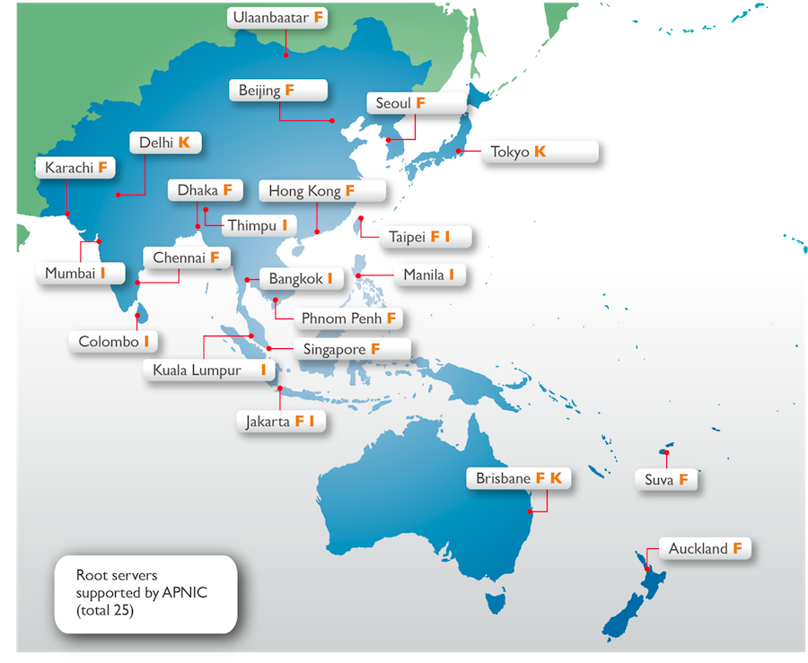
Root Servers in the Region

Slide 12
Information Society Innovation Fund
ISIF is a grants program aimed at stimulating creative solutions to ICT development needs in the Asia Pacific region
From 2009, 23 initiatives in 12 AP economies showcasing innovation, cooperation, and technical knowledge have been supported through grants and awards
In 2011:
  47 nominations from across the region
  4 winning projects presented during Kenya IGF

Slide 13
Information Society Innovation Fund
ISIF is now part of the Seed Alliance
  Alliance for Internet development and digital innovation
  Joint effort with LACNIC and AfriNIC, with generous support from the IDRC
New round of funding to be launched late March 2012
Final reports from 2010 grant recipients now published
Website: www.isif.asia

Slide 14
Thank you

