Slide 1

Collaborating and Communicating
German Valdez,
External Relations Program Director

Slide 2
Overview
IPv6 Activities
IPv6 Program
External Relations
APNIC engagement activities
Supporting the Internet ecosystem
IGF

Slide 3
IPv6 Program
In 2011 the APNIC EC reconfirmed APNIC’s commitment to IPv6 as a critical priority
After IPv4 exhaustion IPv6 provides the only means for the Internet to continue growing sustainably into the future.
Support regional IPv6 activities
APIPv6TF Secretariat
Strong collaboration, outreach, and education activities with all stakeholders
Sharing IPv6 deployment status information
Providing customized information on issues related to IPv6 deployment within local networks
Addressing concerns and issues related to IPv6 deployment

Slide 4
IPv6 Program
Outreach: Major events
IPv6 Transition conference, APRICOT-APAN 2011, Hong Kong
IPv6 Transition Plenary, APNIC 32, Busan, South Korea
Seminar for DNS community, ICANN 41, Singapore
World IPv6 Day, 8 June 2011
Research: APNIC Labs
Leading research on IPv6 readiness
http://labs.apnic.net

Slide 5
Regional Activities
Providing deployment experiences and updates of progress
Pacific Telecommunications Council (PTC), Hawaii, January 2011
Philippines IPv6 Conference, Manila, January 2011
China IPv6 Summit, Beijing, April 2011
IPv6 Workshop, Thailand, July 2011
Asia Pacific Top Level Domain (APTLD), Busan, South Korea, September 2011
Australia IPv6 Summit, Melbourne, October 2011
China Mobile MIRACLE 2011, Beijing, November 2011
Singapore iDA IPv6 Executive Briefing, November 2011
Taiwan IPv6 Summit, Taipei, November 2011

Slide 6
Intergovernmental Activities
Participation in joint sessions with regulators, policymakers, and government to build awareness and support the industry with IPv6 deployment
11th APT Policy and Regulators Forum
APEC TEL 43, 44
Policy and Regulations Forum for the Pacific
Pacific Telecommunications Council (PTC)
Pacific Islands ICT Ministerial Meeting
Hong Kong Office of the Government Chief Information Officer (OGICO)
China Ministry of Industry and Information Technology of the People’s Republic of China (MIIT)
Singapore iDA Government CIO Wing (GCIO) and Technology and Planning Group (TEPL)

Slide 7
External Relations Program
Designed to streamline APNIC’s representation abroad
Coordination framework to enhance participation and use resources for representation more effectively
To manage network of liaisons and improve preparedness of staff representing APNIC
To make partnerships and engagements more strategic
In close coordination with Public Affairs
To coordinate APNIC’s efforts and resources to support the community

Slide 8
APNIC Engagement with the Community
In 2011 APNIC continued engaging and expanding its collaboration within the Asia Pacific Internet community by organizing or participating in:
Network Operator Group (NOG) meetings
IPv6 Summits, conferences, or workshops
National Internet Registry (NIR) meetings
Internet Governance forums
Intergovernmental forums
Internet related events (ICANN, IETF)
ICT events ( CommunicAsia, eASIA)

Slide 9
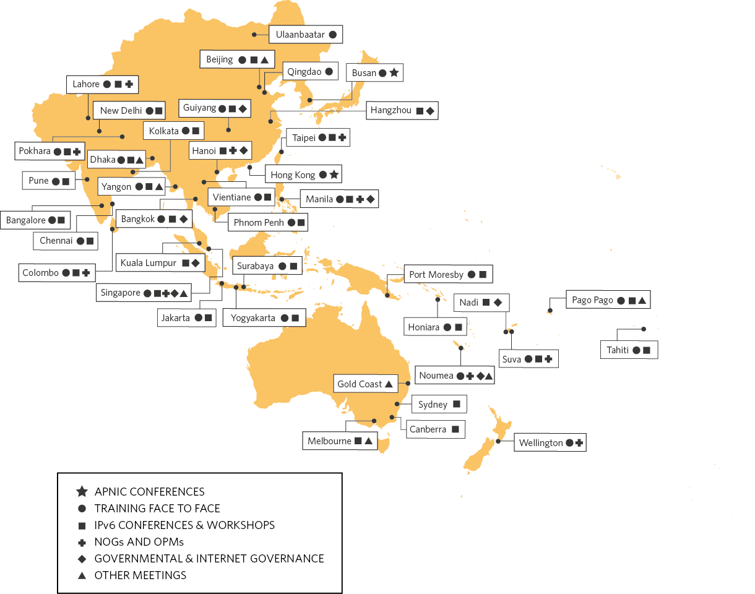
Engagement Activities Across the Region
By Numbers
39 cities in 26 economies
32 IPv6 conferences or workshops
9 NOG and OPM meetings
10 governmental and IGF meetings
7 other meetings (ICT, IETF, ICANN, etc)

Slide 10
Supporting Internet Ecosystem
APNIC supports the functioning of the global Internet through its services in the AP region and also via participation in a global network of technical organizations
Number Resource Organization
Coordinating with IANA and ICANN to allocate the final /8 blocks
Comments to NTIA about the renewal of the IANA contract
NRO Public Affairs Committee formed for global intergovernmental coordination
OECD and ITAC
Through the NRO, APNIC is a founding and active member of the Internet Technical Advisory Committee (ITAC), which is a global coalition of Internet organizations invited by the OECD to provide input on internet-related issues
APNIC provided information about the success of multi-stakeholderism, IPv6 deployment, security and the future of network infrastructure

Slide 11
Internet Governance Forum
Strong support to the continuation of the Internet Governance Forum.
APNIC attended the 2011 IGF in Nairobi, Kenya
Sponsored a remote hub at USP in Suva, Fiji
Total of 18 participants
APNIC supported two regional IGF events
Inaugural Pacific IGF (PacIGF) in New Caledonia
Cooperation agreement signed with the Secretariat of Pacific Community (SPC)
Asia Pacific Regional IGF (APrIGF) in Singapore
IPv6: How ready is Asia for this critical resource
Review of the IANA function
International Law Enforcement

Slide 12
Asia Pacific Telecommunity
APT is an ICT governmental organization representing 38 economies in the region. It’s a feeder entity to the ITU in ICT related topics.
APNIC invited to participate as an expert in several APT workshops
e-Applications/eGovernment
Cybersecurity Forum
APNIC has also collaborated with the Policy and Regulatory Forum (PRF) and Pacific-PRF
Notes:
APT is an ICT governmental organization representing 38 economies in the region., feeder entity to the ITU,

Slide 13
Thank You

