Slide 1
Corporate Support
Richard Brown, Business Director

Slide 2
Corporate Support
Infrastructure
Risk Management
Resource Management
Planning
Process Improvement
People and Culture
Notes:
Introduction to the key aspects of corporate support in 2011
Infrastructure – includes Physical Office , Technical Office Support
Risk Management includes – Insurance, Legal & BCP

Slide 3
Infrastructure
New office establishment
Contract finalization
Service and maintenance contracts in place
Decommissioning old premises
Immediate benefits
On time and within budget
Secure facility
Collaborative environment
Adaptable to APNIC’s future requirements

Slide 4
Infrastructure
Technical Office Support
Three-site redundancy provides resilience for key Secretariat services
Improvement in monitoring of services
Continued 24/7 support for Secretariat technical issues

Slide 5
Risk Management
Insurance
Risk exposure workshops
Risk register
Insurance coverage and gap identification
Legal
Legal representation
Focus on corporate governance
Knowledge management for legal issues
Contract management

Slide 6
Risk Management
Business Continuity Planning (BCP)
Tested during flood crisis – Jan 2011
Regular scenario testing
BCP approach to all activities
Planned collaboration with RIPE NCC

Slide 7
Resource Management
New ERM (Enterprise Resource Management) System
Reduces complexity and automates manual processes
Replaces a range of standalone applications
Real-time, flexible reporting
Custom workflows, approvals, and audit trails
Single source of key organizational data

Slide 8
Resource Management
New ERM functionality:
Financial and management accounting
Procurement and asset management
Role-based reporting and dashboards
Activity/project costing
Interface with APNIC’s internal systems
More to come, including:
Travel and expense management
HR and Payroll
CRM

Slide 9
Planning
Full operational planning process in 2011
Survey report and EC strategic vision
Internal organizational assessments
Review of environment
Analysis of strengths and weaknesses
Budget constraints
Clear priorities for 2012
Defined at all levels and incorporated into individual and team KPI’s
Regular review at strategic ELT meetings

Slide 10
Process Improvement
Implemented best practice for:
Software development methodologies
Improved reporting capabilities, increased communication and information sharing
Greater software quality through test-driven development
Guided by continuous integration principles
More frequent opportunities to make minor course adjustments during a project
Business process modelling
Modelling and documenting processes
Identifying bottlenecks and opportunities for improved efficiency

Slide 11
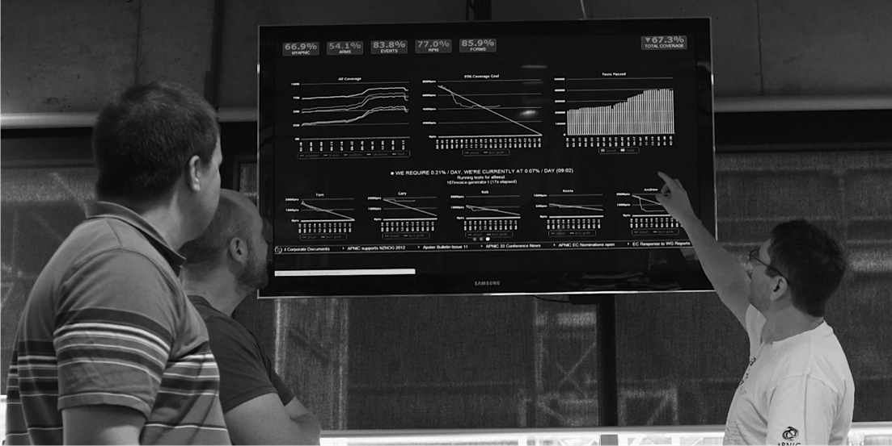
Process Improvement
Status Board
Visibility of current work/priorities
Maintaining focus on required outcomes

Slide 12
People and Culture
Diversity
28 economies
30 languages
Training and development
English conversation group
Lunch ‘n’ Learn program
Job specific training for technical currency
Self-education support

Slide 13
People and Culture
RIR staff exchange program
APNIC publications team member hosted by the RIPE NCC
APNIC hosted a RIPE NCC communications specialist

Slide 14
People and Culture – WH&S
Preparation for Work Health & Safety Act 2012
Policy and procedure review
Staff training and information sessions; online compliance register
Fire warden, CPR, and First aid training

Slide 15
People and Culture
Performance Management
Change from anniversary-based to bi-annual performance reviews in 2011
Six-monthly reviews in May/June
Annual reviews in Nov/Dec
Ensures moderation of results
Certainty for budget planning
Enables alignment of performance to operational planning priorities

Slide 16
Thank You

