Slide 1
ARIN Update
John Curran
APNIC 31

Slide 2
2011 Focus
Continue development and integration of web-based system (ARIN Online)
Outreach on IPv6 adoption
DNSSEC and RPKI
Continue participation in Internet Governance forums
Notes:
High level focus, more on these items on following slides

Slide 3
Public Facing Development Efforts
WHOIS-RWS deployed in June 2010
ARIN Online development progressing steadily
DNSSEC
Now signing zones
Interfaces to allow insertion of DS records coming end of Q1 2011
RPKI
Rolling out production service in Summer of 2011*
Pilot available at http://rpki-pilot.arin.net
*Pending Board Approval
Notes:
ARIN Online - moving to online services via secure login, phasing out email

Slide 4
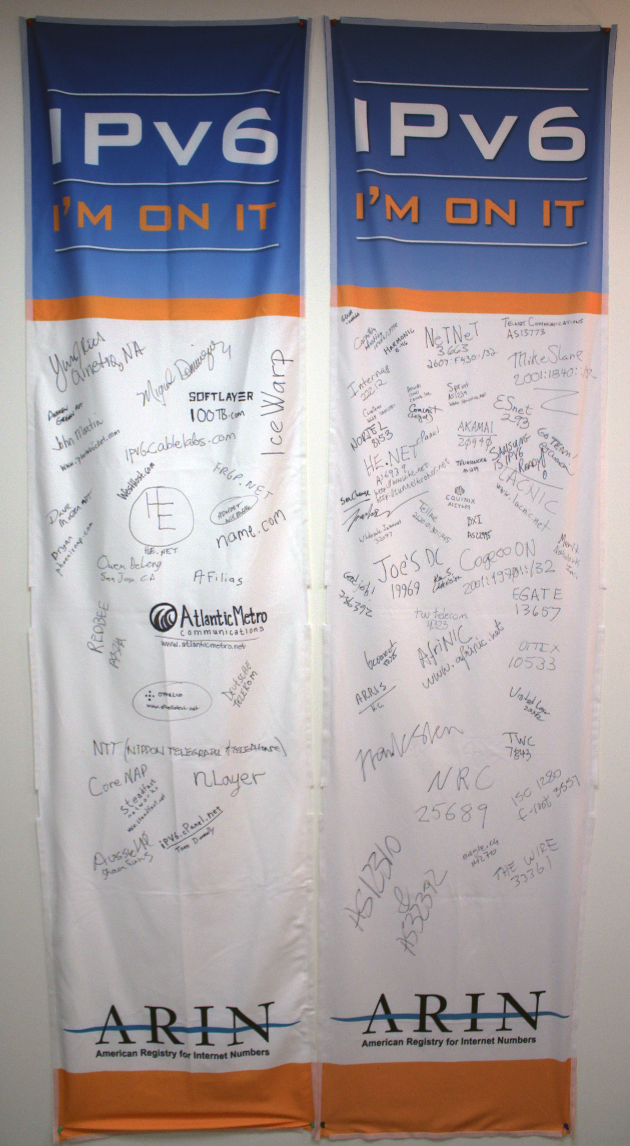
2011 Outreach Events
Ongoing participation in various local, national and international forums, focus on IPv4 depletion and IPv6 adoption. Events include:
CES
Pacific Telecom Conference
Cable Labs
Joint Techs / Internet2
ICT roadshow events
TTVN
IT Roadmap
Game Developers Conference
Enterprise Connect
Satellite 2011
Rocky Mountain IPv6 Summit
Interop
CANTO
FOSE
HostingCON

Slide 5
Recently Implemented Policy
ARIN-2010-1: Waiting List for Unmet IPv4 Requests
“ARIN will make each allocation and assignment as a single continuous range of addresses”
Unused space must be returned to ARIN
ARIN-2010-12: IPv6 Subsequent Allocation
“Subsequent allocations will also be considered for deployments that cannot be accommodated by, nor were accounted for, under the initial allocation.”
Notes:
2010-12 and 2010-1 implemented in January 2011

Slide 6
Soon to be Implemented
ARIN-2010-8: Rework of IPv6 assignment criteria
Nibble boundary assignments based on site counts. Starts with /48 for one to twelve sites, then /44 for 13-192 sites, etc.
“A site is a discrete location that is part of an organization’s network.”
ARIN-2010-14: Standardize IP Reassignment Registration Requirements
Expands “cable IPv4 allocation policy” to all ISPs with residential/DHCP-type customers (lowers utilization threshold, increases utilization information requirements).
Requires SWIP for /64 and larger static reassignments.
Notes:
2010-8 in March 2011
2010-14 TBD

Slide 7
Draft Policy Discussions
ARIN-2011-1: Globally Coordinated Transfer Policy
Allows transfers to/from ARIN region
ARIN-2011-2: Protecting Number Resources
Directs ARIN to go after abandoned/fraudulently obtained resources
ARIN-2011-3: Better IPv6 Allocations for ISPs
Makes it easier to get larger blocks of IPv6 space
ARIN-2011-4: Reserved Pool for Critical Infrastructure
Reserves a v4 /16 for critical infrastructure
ARIN-2011-5: Shared Transition Space for IPv4 Address Extension
Allocates a v4 /10 for ISPs to share (eg. NAT444)

Slide 8
New Policy Proposals
ARIN-prop-126 Compliance Requirement
Directs ARIN to remove DNS services from ISPs that do not properly register reassignment information
ARIN-prop-131 Section X.X. Legacy Addresses
“All IPv4 addresses returned to, recovered, or revoked by ARIN will be made available for registration and distribution in the ARIN region within 30 days.”
ARIN-prop-132 ISP Sub-assignments Do Not Require Specific Customer Relationships
Regarding reassignments… “An ISP is solely responsible for determining whether an organization is a customer…”
Notes:
131 is draft text from the AC, AC still working on text, prop-131 will be on list and go to PPM

Slide 9
New Policy Proposals (cont.)
ARIN-prop-133 No Volunteer Services on Behalf of Unaffiliated Address Blocks
“Except in the specific circumstances described by this policy, ARIN will not provide any services for any organization and/or address block. This includes without limitation all directory services, reverse mapping services, and future services that may be provided to the community.
ARIN-prop-134 Identification of Legitimate Address Holders
Establishes criteria for determining whether an organization is the legitimate address holder for a given IP address block.
ARIN-prop-135 Clarification of draft policy 2009-3
Tells ARIN to not return address space to IANA.

Slide 10
ARIN Meetings
Notes:
And, back to Vancouver in Spring 2012 (contract signed as of 17 Feb. 2011)

