Slide 1
APIX update
APNIC Member Meeting, 2 Mar. 2012
Che-Hoo Cheng / Katsuyasu Toyama
interim co-chairs
APIX

Slide 2
What is APIX?
“Asia-Pacific Internet Exchange”
An association of Internet Exchange Providers in Asia-Pacific region.
just like Euro-IX in Europe
Objectives: To share information about technical, operational, and business issues and solutions regarding Internet Exchange.
Notes:
APIX is Asia Pacific Internet Exchange, an association of Internet exchanges in Asia Pacific region.
This is just like Euro-IX forum, the association in European region, a closed group of internet exchange.
The main objectives are:

Slide 3
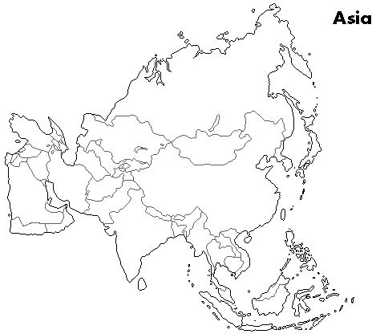
Participating IXPs
14 IXPs in AP region
BD: BDIX(Dhaka)
HK: HKIX(Hong Kong)
JP: BBIX, Dix-ie, JPIX, JPNAP
KR: KINX(Seoul)
IN: NIXI (7 locations in India)
MY: MyIX (KL)
NP: NP-IX(Katmandu)
SG: SGIX(Singapore), SOX(Singapore)
VN: VNIX(Hanoi/HCMC)
AP: Equinix (Hong Kong, Singapore, Tokyo, Sydney)
Dix-ie
VNIX
SOX
* MyIX is a newcomer.

Slide 4
Scope
Topics discussed in APIX meetings
Tools
Standardization
Peering issues
Education
Research and Development
Exchange point architecture
Technologies for internet exchanges
Operational issues
Requests to vendors
Traffic
trend, analysis, projection, and so on

Slide 5
Organization and its operation
Current (Interim) Chair and Co-chairs
Katsuyasu Toyama (JPNAP)
Raphael Ho (Equinix)
Che-Hoo Cheng (HKIX)
Gaurab Raj Upadhaya (NP-IX)
Akira Kato (Dix-ie)

Slide 6
Meeting history
# | Date | Place | Attendees | IXPs in AP
5th | 26 Feb. 2012 Sunday | New Delhi (India) | 27 people (22 from IXPs) | 11 IXPs in AP (2 remotely)
4th | 30 Aug. 2011 Tuesday | Busan (Korea) | 23 people (21 from IXPs) | 12 IXPs in AP
3rd | 20 Feb. 2011 Sunday | Hong Kong (Hong Kong) | 31 people (23 from IXPs) | 10 IXPs in AP
2nd | 23 Aug. 2010 Monday | Gold Coast (Australia) | 11 people (9 from IXPs) | 7 IXPs in AP
1st | 1 Mar. 2010 Monday | Kuala Lumpur (Malaysia) | 15 people (14 from IXPs) | 7 IXPs in AP
Preliminary | 25 Aug. 2009 Tuesday | Beijing (China) | 14 people (8 from IXPs)
Attendees are limited only to IXP people.
Supporters, who contribute to APIX activities, may be invited.

Slide 7
5th Meeting
Participated IXPs
Asia-Pacific
BD: BDIX
HK: HKIX
JP: BBIX,JPIX, JPNAP, Dix-ie
KR: KINX
IN: NIXI
MY: MyIX
NP: NP-IX
SG: SGIX, SOX
VN: VNIX
AP: Equinix
Other regions
Europe
DE: DE-CIX
NL: AMS-IX
SE: Netnod
UK: LONAP
Latin America
BR: PTT Metro
IXP associations
Euro-IX
LAC-IX
Red names denote participated IXPs, remotely participated IXPs are denoted with underline

Slide 8
Summary of 5th meeting
Administrative session
APIX bylaws are adopted.
Organization architecture and membership are defined.
Technical session
IXP update
Invited talks
Update about CISCO Route Server Development
Rajesh Parikh @ CISCO
ARP Hijacking Mitigation
Henk Steenman @ AMS-IX
Jumbo Frame Deployment at IXPs
Martin J. Levy @ Hurricane Electric

Slide 9
Organization Architecture
Association (APIX)
“Patron”
Member
(IXP)
Member
(IXP)
Member
(IXP)
Member
(IXP)
representative
Selects committee members
Delegates some tasks
General Meeting
Chair
Secretary
Treasurer
Steering Committee

Slide 10
Outstanding Issues
Bylaws modification
Legal entity
Membership Fee
Collaboration with other IXP associations
Euro-IX and LAC-IX

Slide 11
Thank you!
Contact:
apix-admin (at) apix.asia

