Slide 1
Welcome to APNIC 34 Phnom Penh, Cambodia
August 2012

Slide 2
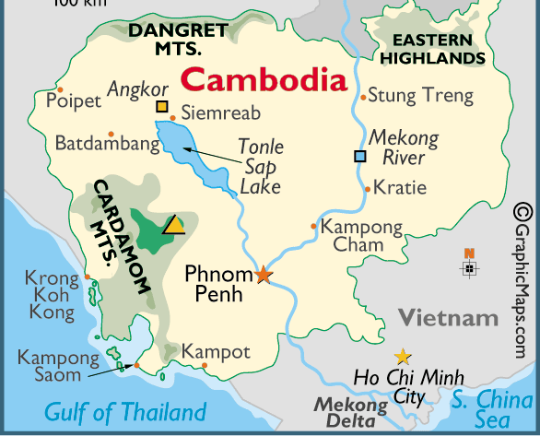
1. Phnom Penh Fast Facts
The Capital of Cambodia – The Kingdom of Wonder
Population: 2.2 million (2011 est.)
Languages: Khmer, English, and Chinese
Currency : Riel (but US Dollar is generally accepted in all locations)
Average July temperatures: 24.4 – 32.2^{O}C
Phnom Penh, once known as the ‘Pearl of Asia’,
is largest city in Cambodia
The metropolis is located on the intersection of the banks of Mekong, Tonle Sap, and Bassac rivers
The alluring capital city features a wide variety of historical and cultural attractions

Slide 3
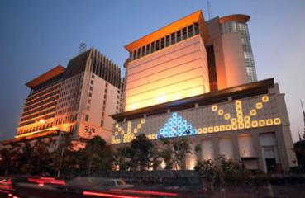
2. APNIC 34 in Phnom Penh
Time
27 – 31 August 2012
Venue
NagaWorld Hotel & Entertainment Complex
Phnom Penh, Cambodia

Slide 4
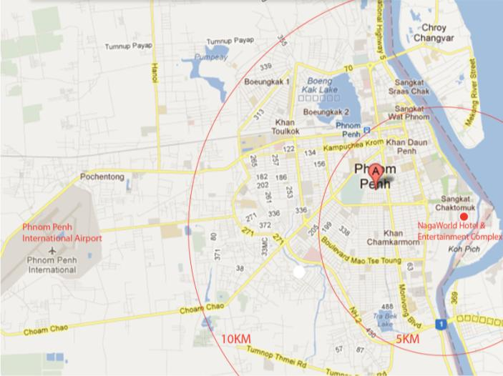
3. Location
Right in the central of Phnom Penh in the Hun Sen Park
Nagaworld Hotel & Entertainment Complex is just:
off the riverfront
within sight of the Independence Monument

Slide 5
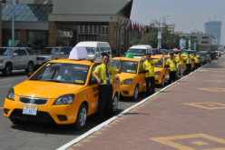
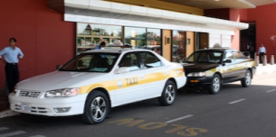
4. Airport Connections
Airport proximity:
~ 15KM from the hotel (30 minutes by car)
Taxi services:
The current fixed charge is US$10 for a taxi
from the airport to any one destination
in the city center
Hotel – Airport Transportation services:
Ford USD18.00/way Max 3 pax Previa USD28.00/way Max 5-6 pax Mini Van USD40.00/way Max 12 pax | Chrysler USD55.00/way Max 3 pax Coaster USD55.00/way Max 25-30 pax Mercedes Benz USD70.00/way Max 3 pax

Slide 6
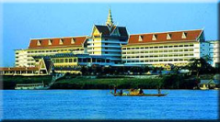
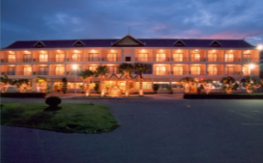
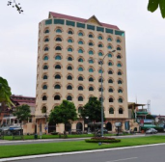
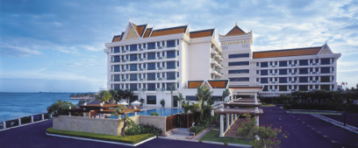
5. Accommodations
Hotel | Grade | Rooms | Rate (incl. taxes) | Distance from Venue
NagaWorld Hotel & Entertainment Complex | ★★★★★ | 501 | $80~$280 | Venue
Cambodiana Hotel | ★★★★ | 238 | $72~$327 | 600 meters
Himawari Hotel Apartments | ★★★★★ | 115 | $136-$275 | 650 meters
Landscape Hotel | ★★★ | 56 | $55-$77 | 650 meters
Imperial Garden Villa & Hotel | ★★★ | 88 | $62-$202 | 500 meters
Total
NagaWorld Hotel
Cambodiana Hotel
Imperial Garden Villa & Hotel
Landscape Hotel
Himawari Hotel Apartments

Slide 7
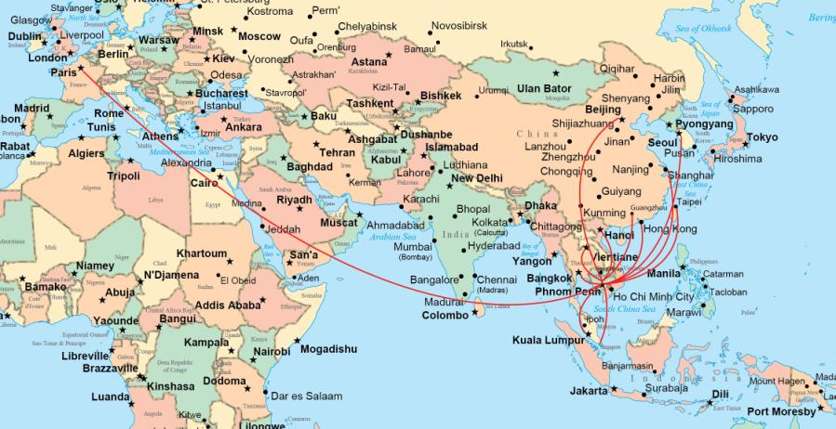
5. Transportation
International flights from/to Phnom Penh

Slide 8
5. Transportation (Cont. )
Direct international flights from/to Phnom Penh
Direct international flights from/to Siem Reap
Phnom Penh
Bangkok
Beijing
Guangzhou
Hanoi
Hochiminh City
Hongkong
Incheon
Kuala Lumpur
Paris
Singapore
Shanghai
Taipei
Vientiane
Yangon
Bangkok
Cairns
Danang
Guangzhou
Hanoi
Hochiminh City
Incheon
Kuala Lumpur Luang Prabang Pakse
Pusan
Singapore
Taipei
Vientiane
Yangon
Siem Reap

Slide 9
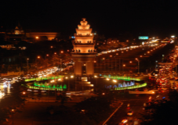
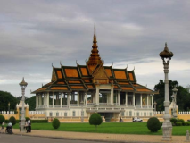
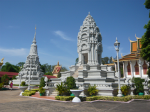
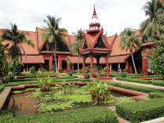
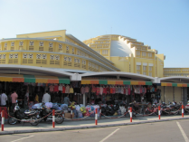
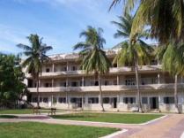
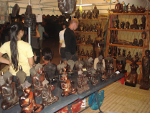
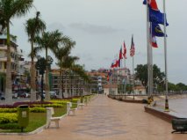
6. City Tour
Independence Monument
Royal Palace
Silver Pagoda
National Museum
Riverfront Park
Central Market
Tuol Sleng Museum
Night Market

Slide 10
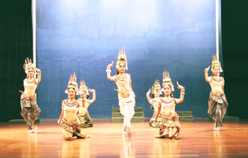
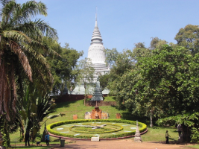
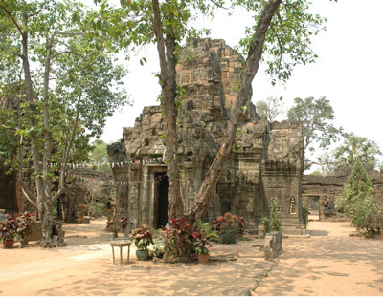
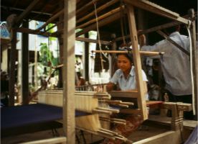
7. Cultural Heritage
Amok
Apsara Dance
Wat Phnom
Ta Prohm -Tonle Bati lake
Koh Dach Silk Island

Slide 11
8. Getting a Visa
2 easy ways to get a Cambodia Visa
E-Visa
Apply on: http://evisa.mfaic.gov.kh/
On-arrival Visa
Apply upon arrival at the below 5 ports of entry
- Fill out an online form
- Upload a passport photo
- Pay for Visa application fee $25 (by credit card or PayPal)
- Print out 2 copies of visa for arrival & departure after the process completed (about 15-20 minutes)
- By air: Pochentong International Airport/ Siem Reap International Airport
- By land: Aranyapathet-Poipet Border with Thailand/ Trat-Koh Kong Border with Thailand/ Moc Bai – Bavet Border with Vietnam
Requirements
A passport validity of more than 06 months balance at time of entry
A recent passport photo (3 x 4 cm)
$25 for E-visa or $20 cash for on-arrival visa application fee

Slide 12
8. Getting a Visa (cont.)
Delegates are recommended to apply for tourist visa for the following reasons:
Only tourist visa can be applied online
The fee for business visa is $5 more than the normal visa (apply on arrival)
The only difference between tourist visa and business visa is the length of stay
You just have to apply for business visa if you wish to stay in Cambodia for more than 30 days ☺
IMPORTANT NOTES
Visa Exemption: Laos, Malaysia, Philippines, Singapore, Vietnam, Thailand, Indonesia
Countries not supported E-Visa: Afghanistan, Algeria, Arab Saudi, Bangladesh, Iran, Iraq, Pakistan, Sri Lanka, Sudan, Nigeria (Please apply your Visa from your nearest embassy or on-arrival).

Slide 13
8. Sponsorship
Sponsor APNIC 34, you will
Position your brand in a high-profile event with international audience of Internet leaders
Expose and promote your products and services to the niche Internet market
Help encourage growth in the Asia Pacific Internet community
Welcome to APNIC 34 with flexible sponsorship options to align with your marketing objectives

Slide 14
See you in APNIC 34
Phnom Penh - Cambodia

